Slide 1

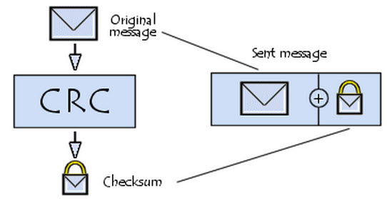
CRC
NETWORKS ASSIGNMENT

Slide 2
Presented by
Ahmad Ashraf Abdelfatah
Arwa Ibrahim Muhamed
Ahmed Ragab Shaaban
Raheeq Alaa-Eldeen Muhamed

Slide 3
Project Description
Our program consists of 3 Parts:
Generator Program: reads message input & polynomial from the Input.txt file, and then outputs the message to be transmitted in Transmitted_message.txt file.
Verifier Program: Checks whether the message is correct or not , it’s output in Verifier_message.txt file.
Altering Code: a command that alters the message and sends it to the verifier to ensure that it’s doing its function properly and outputting an error in that case.

Slide 4
How to use
Download the .exe file and the sample test cases from GitHub
Put your test cases in the same directory and name it Input.txt
Run the program and choose the mode
Mode 1: Verifying mode, should output “message is Correct :D” as it’s the same message.
Mode 2: Altering, it alters the left-most bit and then runs (Mode 1) again, should output “message is not Correct :(” as the message has been altered.
You will find Transmitted_message.txt file in both modes contains the transmitted message .

Slide 5
Important notes :
Input file must contains 2 lines , the first contains the message and the other contain the polynomial .
In mode 2 “generator <file | alter arg | verifier” be sure that only one space between alter & the arg .
Don’t forget to write your mode in the cmd after running the program .
And the important thing don’t forget to put the Input.txt in the same directory as the CRC.exe file .

Slide 6
Sample I/O – Test Cases

Slide 7
Thank you :)

